Slide 1
Disaggregating patient race and ethnicity
A primer for community-based organizations and advocates

Slide 2
Reasons to disaggregate race/ethnicity
Minimum standard race categories mask within-group health disparities based on genetic and/or sociocultural factors
Pew Research Center, 2021
Federally-defined race does not always align with self-identifications
“Gold Standard” = self-reporting
American Heart Association, 2020
Disaggregated race categories can offer more options for self-identification and can be rolled up into standard
Standardization for interoperability and data comparability

Slide 3
Planning
Image source: American Hospital Association,
https://www.aha.org/aha-center-health-innovation-market-scan/2021-03-09-3-data-driven-keys-address-health-equity

Slide 4
Category Selection
Local stakeholder convening at all stages (planning, implementation, evaluation, etc.) – including, but not limited to:
Health providers such as hospitals, small and solo practices, mid-sized practices, family and general practitioners as well as specialties
Patients and patient advocates
Civil rights groups, social service organizations, cultural groups
Insurers, electronic medical records services, IT professionals
Data managers, biostatisticians, and health equity researchers
The National Committee for Quality Assurance recommendations, presented during UCLA-hosted webinar, "Legal and Regulatory Guidance for Racial/Ethnic Data Disaggregation in Health Data Sets."
Link: https://www.youtube.com/watch?v=ffTOob-m54M&t=29s

Slide 5
Category Selection
Community deliberations
Focus groups, public forums, and other methods of qualitative information sharing
Consensus is not the goal
Survey a broad sample of patients
Include open-ended self-reporting option to see common terms/identities
Use qualitative findings, Census/ACS, and other existing data sources to pilot test a disaggregated questionnaire
Example flyer developed by the New York Academy of Medicine to recruit focus group participants.
Purpose: to inform race/ethnicity questionnaire format, verbiage, and disaggregated race/ethnicity options.

Slide 6
The CBO Role
Bring community concerns to the table
Privacy concerns
Potential for harm/stereotyping from reporting disaggregated data
Cultural and linguistic appropriateness of terms
Ensuring transparency
Recommend accountability mechanisms
Advocate for diversity & inclusion
Ensure inclusion of all communities on disaggregated race/ethnicity data collection forms
Invite culturally diverse and cross-sector collaborators to community workgroups

Slide 7
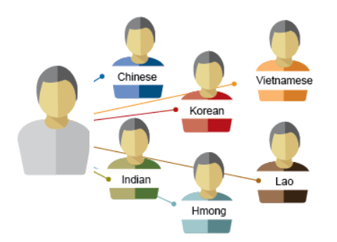
Data Collection
Image source: Minnesota Compass,
https://www.mncompass.org/data-insights/articles/race-data-disaggregation-what-does-it-mean-why-does-it-matter

Slide 8
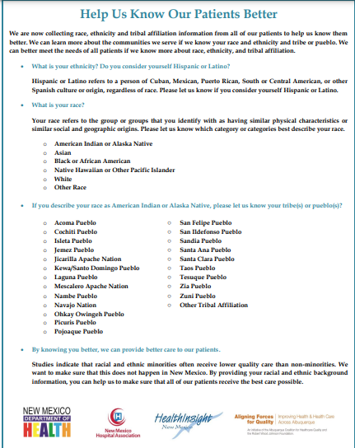
Community education to increase response
Describing race/ethnicity
Conceptualization of race may be different in certain cultures and/or for those who have spent most of their lives outside the U.S.
Emphasizing importance of race/ethnicity disaggregation
Community buy-in
Forums
Written materials: flyers, letters, etc
Public forums
Handout developed by New Mexico Department of Health to explain purpose of race/ethnicity collection to patients.

Slide 9
Addressing key concerns
Example Concerns
CBO Response / Talking
Privacy and confidentiality
Plain-language, multi-lingual verbal and written explanations:
Privacy = "I choose not to share my personal information"
Confidentiality = "You must not share my personal information"
Purpose/use of race/ethnicity data
Data disclosure is optional
Protocols to protect privacy and confidentiality
Stereotyping
Data disaggregation highlights diversity
CBOs will work with leaders to report data in a way that includes historical context and highlights community assets/strengths
Increased competition for resources?
Resource allocation will be more equitable, rather than taking away from certain communities.

Slide 10
Analysis & Reporting
Image source: National Academies of Sciences, Engineering, and Medicine
https://nap.nationalacademies.org/catalog/23576/framing-the-dialogue-on-race-and-ethnicity-to-advance-health-equity

Slide 11
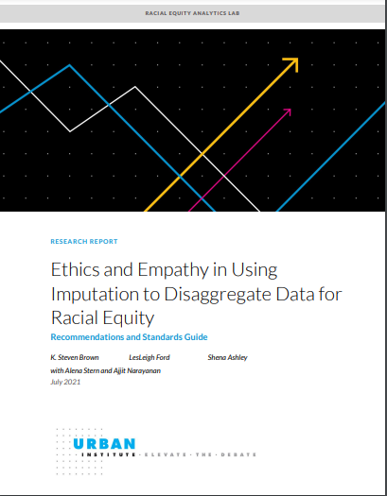
Ethics and equity in data analysis
CBOs can work with technical experts to promote equity-driven methods to data analysis
See toolkit for data managers/systems admins/analysts for recommended resources
Key talking points:
Self-reporting is a gold standard
Allow multiple category selection
If feasible, allow open-ended (write-in) response
Space limitations are not an adequate excuse for excluding locally relevant populations from data collection forms
Balancing disclosure avoidance with data transparency for smaller populations
Ensuring imputation methods (addressing missing data) are meant for group-level analysis, and should not be used to make inferences about individual-level race/ethnicity
Report on ethics & statistical methods from the Urban Instiute Racial Equity Analytics Lab. https://www.urban.org/sites/default/files/publication/104512/ethics-and-empathy-in-using-imputation-to-disaggregate-data-for-racial-equity_1.pdf

Slide 12
Asset framing
"Asset framing is a narrative model that defines people by their assets and aspirations before noting the challenges deficits. This model invests in people for their continued benefit to society"
(California Health Care Foundation)
DON'T
DO
Report disparities without context
Describe communities/groups as victims or define them by their challenges
Use stigmatizing language such as "disadvantaged" or "underprivileged"
Preface reports about specific racial/ethnic communities with aspirational and positive language
Highlight assets and strengths with concrete examples
Foreground root causes of issues ("focus on the system")
E.g. poorly funded healthcare infrastructure

Slide 13
Monitoring & Evaluation
Image source: National Academy of Medicine
https://nam.edu/an-equity-agenda-for-the-field-of-health-care-quality-improvement/

Slide 14
Quality improvement steps
Maintain stakeholder workgroups to monitor progress:
Request periodic data reports:
Evaluate response rates & any changes in rate over time
Highlight differences in response between groups
Hear anecdotes and perspectives from community educators and data collectors
Ensure that leaders continue to incorporate cross-sector findings and community voices into survey design, collection/analysis methods, reporting, and dissemination plans
Ongoing Community Engagement
Request feedback frequently from all groups
Consider education level, age, occupation, gender, and other differences
Use feedback to adjust educational materials, with goal of improving message effectiveness and learning about barriers/success factors

