Slide 1
Equity-centered data governance, analysis, and reporting of disaggregated race/ethnicity
A guide for data managers, systems administrators, and analysts

Slide 2
Issues with current race/ethnicity data
How can race/ethnicity data be of poor quality?
Missing Data
Data Disaggregation
Why is poor race/ethnicity data important?
Stymies the representativeness of pipeline of future research and practice
Poor race/ethnicity data is systemic racism

Slide 3
Reasons to disaggregate race/ethnicity
Minimum standard race categories mask within-group health disparities based on genetic and/or sociocultural factors
Pew Research Center, 2021
Federally-defined race does not always align with self-identifications
“Gold Standard” = self-reporting
American Heart Association, 2020
Disaggregated race categories can offer more options for self-identification and can be rolled up into standard
Standardization for interoperability and data comparability

Slide 4
Planning
Image source: American Hospital Association,
https://www.aha.org/aha-center-health-innovation-market-scan/2021-03-09-3-data-driven-keys-address-health-equity

Slide 5
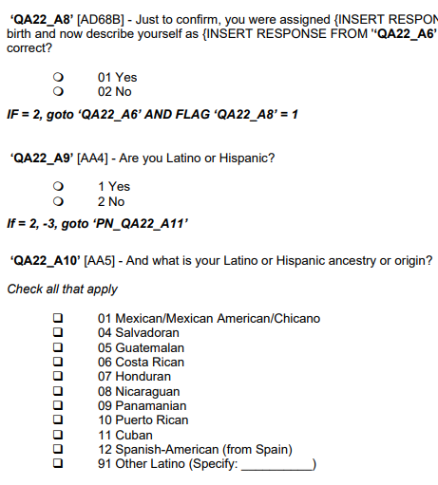
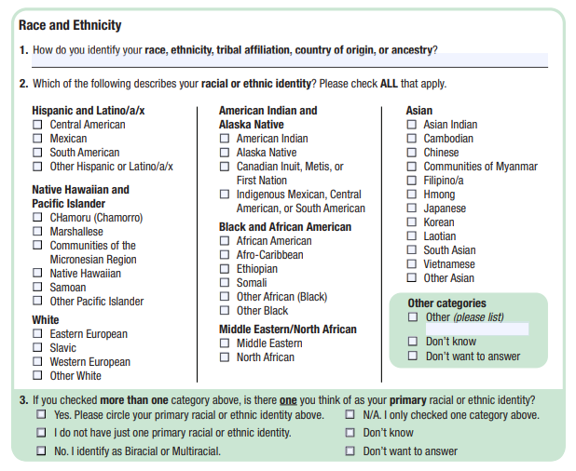
Category Selection
Community based organizations (CBOs) and forums for community feedback should guide category selection, terminology, and other survey design elements
Request feedback from organizations to ensure community response
More detailed guidance found in CBO guides
Example community-informed surveys:
Source: California Health Interview Survey https://healthpolicy.ucla.edu/chis/design/Documents/2022%20Questionnaires%20and%20Topics%20List/CHIS%202022%20CAWI%20v1.05%2024FEB2022%20%20Adult%20Questionnaire.pdf
Source: Oregon Health Authority, https://www.oregon.gov/oha/oei/pages/reald.aspx

Slide 6
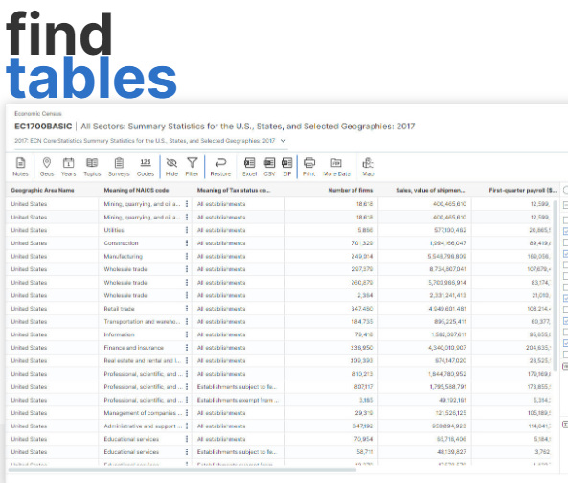
Category Selection
Data-driven methods selecting limited disaggregated categories:
Data sets such as the American Community Survey's ancestry tables (found at data.census.gov)
Other local surveys such as the California Health Information Survey (CHIS) include disaggregated race/ethnicity information
These methods should be used in combination with qualitative feedback from community-based organizations, patient advocate groups, etc.
Provide an option for excluded groups:
“Another group not listed here” to account for those excluded groups. Avoid using language such as “Other” for this response option.
Include a write-in option, which may give information about inclusivity gaps
Explore local Ancestry info at data.census.gov

Slide 7
Data governance
System considerations
Adding/expanding categories to existing records
Costs
Re-aggregation capabilities
Compatibility with other systems
Multiple race/ethnicity selection

Slide 8
Data cleaning
Retrospectively improving race/ethnicity data & imputation
Starting point for deciding more granular inquiry of race/ethnicity
NOT a replacement for self-reporting race/ethnicity
NOT meant to make individual-level inference about race/ethnicity (group analysis only)
More often used to impute OMB standard race ethnicity categories (not disaggregated categories, with exceptions)
Method types for retrospective data cleaning
Expert review
Name list
Name algorithm
Machine learning
Data Linkage
Other

Slide 9
"Ethics Checkpoints" before imputing
Before imputation, audit input data for bias
During imputation, examine where bias could be introduced at each step
After imputation, assess whether imputed race/ethnicity are accurate enough to be used ethically for analytic purposes
Detailed guidance:
Ethics and Empathy in Using Imputation to Disaggregate Data for Racial Equity: Recommendations and Standards Guide. Urban Institute. Available from: https://www.urban.org/sites/default/files/publication/104512/ethics-and-empathy-in-using-imputation-to-disaggregate-data-for-racial-equity_1.pdf
Remember: community collaboration can strengthen data equity procedures

Slide 10
Method Strengths and Limitation
Name Lists User reference lists that directly translate an individual’s surname to a corresponding race/ethnicity category
Advantages:
Disadvantages
Minimal technical expertise
Describe communities/groups as victims or define them by their challenges
Transferrable to other populations
Typically developed larger race/ethnicity groups
Frequently targets only one race/ethnicity group

Slide 11
Method Strengths and Limitation
Name algorithms - Use a muti-step sequence of instructions predetermined by the researcher, leveraging not only surname information but other additional secondary dataset variables
Advantages:
Disadvantages
Higher accuracy better coverage than Name Lists
Appropriate for large data sets
Target multiple race/ethnicity groups
Transferrable to other populations
Requires high level of technical expertise
Typically developed for larger race/ethnicity groups

Slide 12
Method Strengths and Limitation
Machine Learning- Use prediction models that automatically analyzed patterns in data to infer race/ethnicity
Advantages:
Disadvantages
Appropriate for large data sets
Targets multiple race/ethnicity groups
Targets smaller racial/ethnic minority groups
Requires technical expertise
Limited transferability

Slide 13
Method Strengths and Limitation
Data linkage - Connects individuals from one dataset with missing race/ethnicity information to another dataset with complete information
Advantages:
Disadvantages
If done correctly, high level of accuracy
Appropriate for large data sets
Requires access to a linkable gold standard

Slide 14
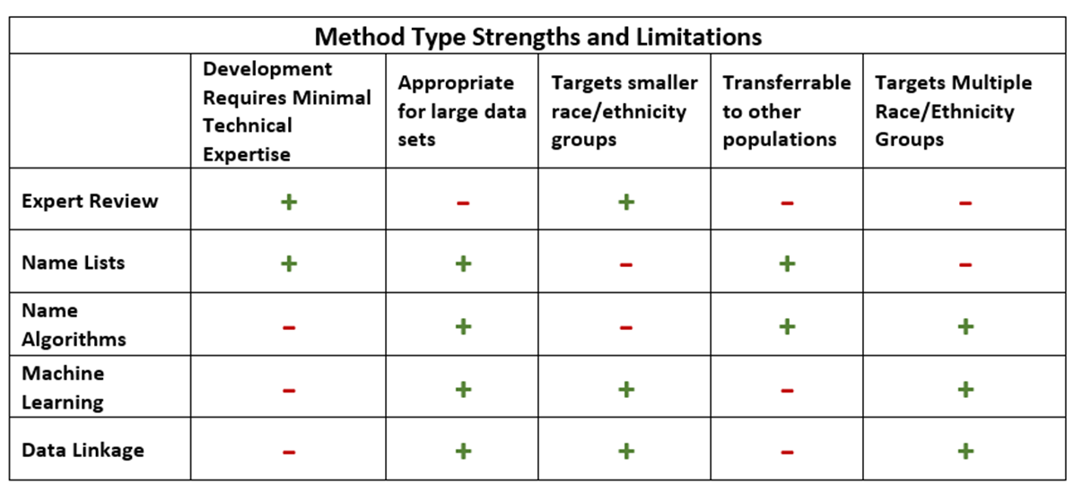
Which method is best?
Other questions to consider:
What race/ethnicity response set are you trying to improve?
What is the population to whom you want to apply the method?
What inputs are available in your data?

Slide 15
Bayesian Improved Surname Geocoding Method (BISG)
Developed by Elliot et al. at RAND
Endorsed by
Strengths
Name algorithm – surname, residential address
Leverages Census Surname Lists and Census Geocode data
Imputes at population level
Can be incorporated into multinomial regression
National Academy of Medicine
National Committee for Quality Assurance
National Quality Forum
Used by
Limitations
Kaiser Permanente
Cigna
Aetna
Centers for Medicaid and Medicare Services
Imputes only six aggregate categories (AI/AN, White, Black, API, Hispanic, Multiracial)
Elliott MN, Fremont A, Morrison PA, Pantoja P, Lurie N.A new method for estimating race/ethnicity and associated disparities where administrative records lack self-reported race/ethnicity. Health Services Research. 2008;43(5 Pt 1):1722-36

Slide 16
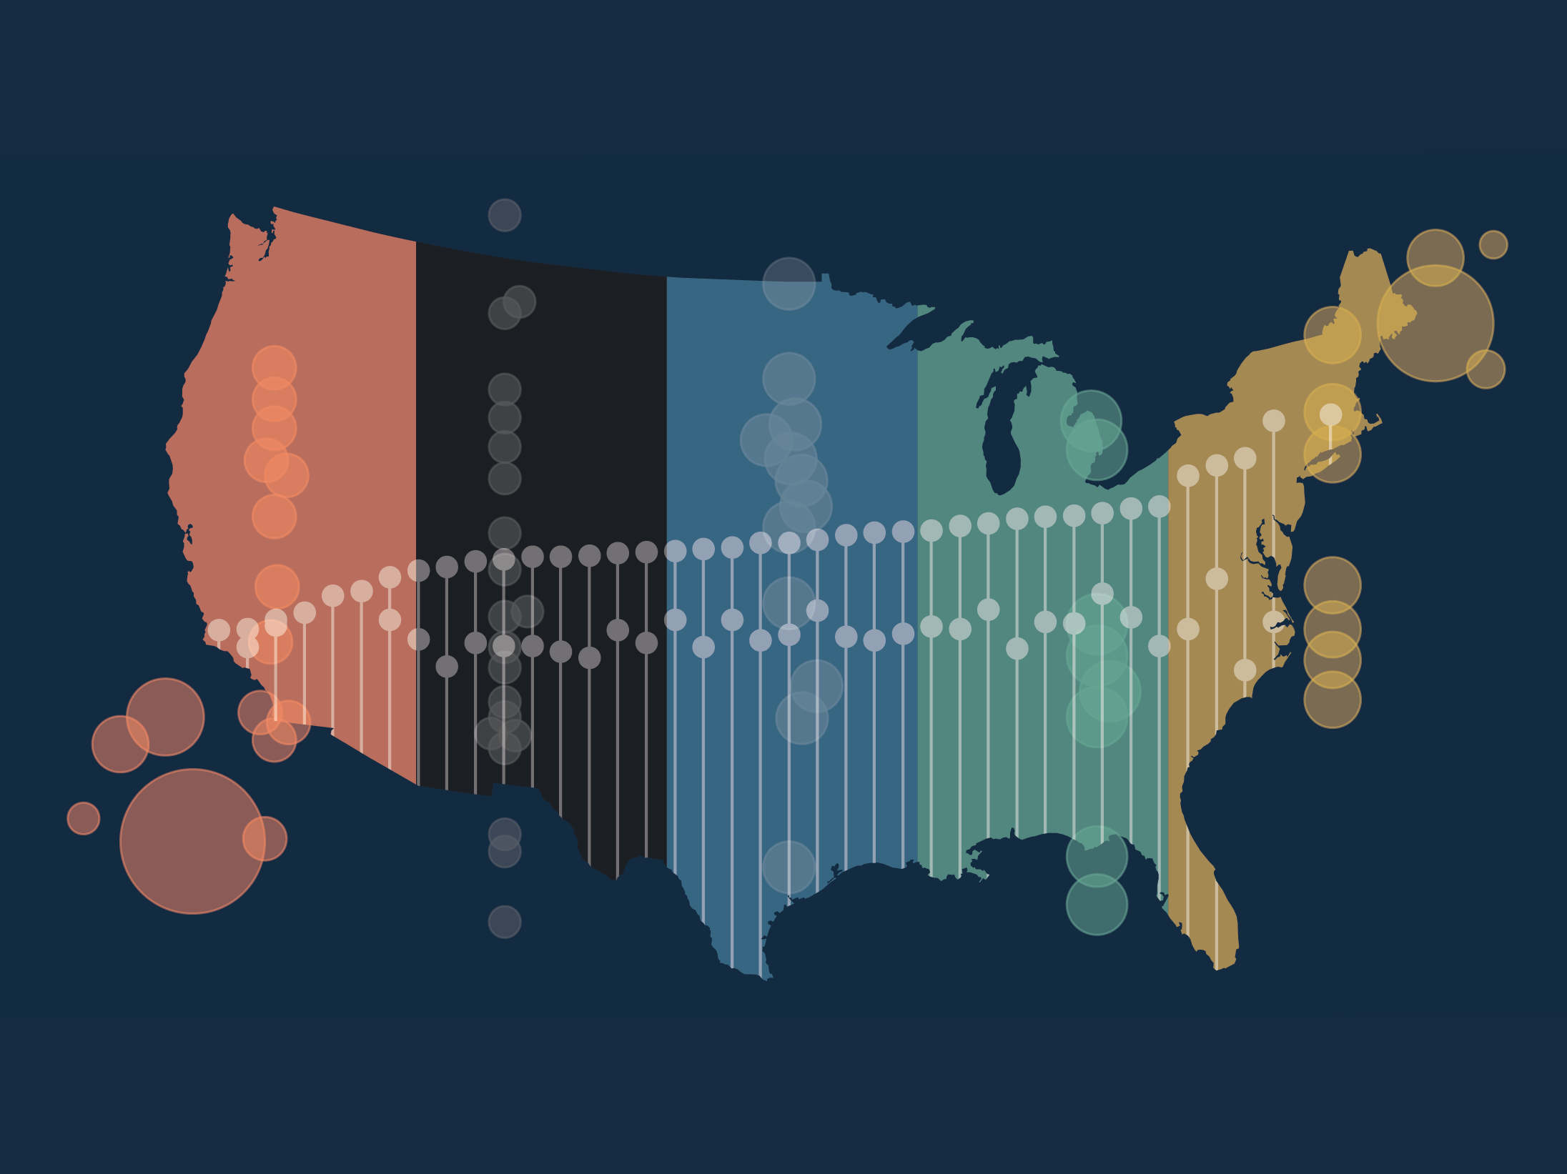
Data analysis and reporting
Image source: The Commonwealth Fund,
https://www.commonwealthfund.org/publications/scorecard/2021/nov/achieving-racial-ethnic-equity-us-health-care-state-performance

Slide 17
Small sample sizes
Privacy protection strategies (aka disclosure avoidance):
Restrict access to data to a small set of “trusted researchers”
Suppress and aggregate data from small populations
Releasing only limited data
Make sure disclosure avoidance strategies do not inadvertently distort or misrepresent data in published reports​

Slide 18
Free text responses
Open-ended response recommended by Robert Wood Johnson Foundation, Institute of Medicine, UCLA, and others
Coding free text responses
Manual coding for small samples
Use automated coding procedures for large data sets
Matching responses to those in preexisting dictionary
Algorithms based on machine learning (ex: natural language processing)
See UCLA webinar: "Coding and Machine-Learning Strategies for Disaggregated Racial/Ethnic data" for recommended programming languages/software

Slide 19
Multiple selection
Why allow multiple category selection on forms?
Individuals who are considered multiracial are among the most rapidly growing populations in the U.S.
Forcing multiracial individuals to choose one race/ethnicity over the other can lead to population undercounts
Important considerations (see resource guide):
Survey format
Checkboxes vs. Radio Dials
Write-in options
Wording
Make clear that multiple selection is allowed
Tabulation and statistical methods

Slide 20
Reporting statistics
Foster good working relationships with community and cultural organizations to avoid group mischaracterization/stereotyping in data reports to stakeholders and the lay public
Make feedback requests from orgs with cultural expertise a standard practice
Avoid harmful statistical comparisons
Refrain from applying positive values to outcomes associated with White populations and negatively measuring people of color by those outcomes
Ex: "Teen pregnancy in White populations is X times lower than in Hispanic/Latino populations."
Apply "asset-framing" rather than highlighting deficits in communities of color whenever possible.

