Slide 1

Citation:
NYU Center for the Study of Asian American Health and NYU-CUNY Prevention Research Center (2017). “DREAM Project (Diabetes Research, Education, and Action for Minorities) Curriculum: Diabetes Management Resources for the Bangladeshi Community.” New York, NY
Acknowledgements: This protocol and associated curriculum materials were developed with support by Grant Numbers P60 MD000538 (NIH National Institute for Minority Health and Health Disparities), 1U48 DP001904-04 (Centers for Disease Control and Prevention), U58 DP004685 (Centers for Disease Control and Prevention New REACH Program), UL1 TR000038 (National Center for Advancing Translational Sciences), and funding from the New York City Department of Health and Mental Hygiene.

Slide 2
Consent Form

Slide 3

Baseline Survey

Slide 4
Group Agreements
    Try to come to every class
    If you cannot make it to the class, please call Nahar or Mamnun
    Come on time
    Respect Confidentiality (what is said in the group stays in the group).
    Listen to and support each other
    Be Respectful of your classmates’ view points
    Step up, Step back (if you are usually quiet, speak up, if you usually tend to talk a lot, take a step back and let others speak)
    Turn off your cell phone or put it on vibrate
    Complete any assigned homework for the week

Slide 5

Buddy System

Slide 6
Physical Activity exercise

Slide 7

Today’s Discussion
At the end of this session, participants will be able to:
Learn an easy to do physical activity
Define what is diabetes
Understand the Signs and Symptoms of Diabetes
Learn about high and low blood sugar
Separate the Myths from the facts about diabetes
Get information on ways to manage your diabetes through your health care provider
Get knowledge on how to manage diabetes at home
List the Complications of Diabetes
Describe what people can do to manage diabetes.

Slide 8

Diabetes myths and facts

Slide 9

Myth #1 You can catch diabetes from someone else.
Notes:
Fact taken from http://www.diabetes.org/diabetes-myths.jsp. American Diabetes Association

Slide 10
Fact # 1
Fact- No. Diabetes is not contagious. It can’t be caught like a cold or flu. There seems to be some genetic link in diabetes, particularly type 2 diabetes

Slide 11



Myth #2 People with diabetes can't eat sweets or chocolate, and eating too much sugar causes diabetes.

Slide 12
Fact # 2
Fact – No. If eaten as part of a healthy meal plan, or combined with exercise, sweets and desserts can be eaten by people with diabetes.
Diabetes is caused by a combination of genetic and lifestyle factors.
Although being overweight does increase your risk for developing type 2 diabetes.

Slide 13



Myth #3 People with diabetes should eat special diabetic foods, and If you have diabetes, you should only eat small amounts of starchy foods, such as bread, potatoes and pasta.

Slide 14
Fact # 3
Fact-A healthy meal plan for people with diabetes is the same as that for everyone – low in fat, moderate in salt and sugar, with meals based on whole grain foods, vegetables and fruit.
Diabetic and “dietetic” versions of sugar-containing foods offer no special benefit.
Starchy foods can be eaten but what is important is portion size.
For most people with diabetes, having 3-4 servings of carbohydrate-containing foods is about right.

Slide 15


Myth #4 People with diabetes are more likely to get colds and other illnesses.

Slide 16
Fact # 4
Fact- No. You are no more likely to get a cold or another illness if you have diabetes.
However, people with diabetes are advised to get flu shots.

Slide 17
Myth 5- One should not exercise if they have chronic disease like diabetes.

Slide 18
Fact # 5:
No, regular exercise is important for everyone—but it is especially important if you have diabetes.
Regular exercise helps control the amount of sugar in the blood and increase the levels of HDL (good) cholesterol.
It also burns excess calorie and fat to help you achieve optimal weight.
Keeping a healthy weight is an important part of taking care of your diabetes.

Slide 19


Myth #6 Fruit is a healthy food. Therefore, it is ok to eat as much of it as you wish.

Slide 20
Fact # 6
Fact- Fruits are healthy as they contain fiber and vitamins and minerals.
BUT, fruits which are very high in sugar such as mangoes and papaya should be avoided/eaten in moderation.
Keep a check on the amount, frequency and types of fruits you should eat.

Slide 21
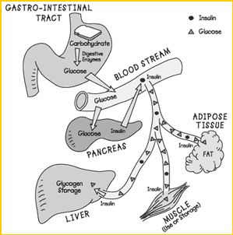
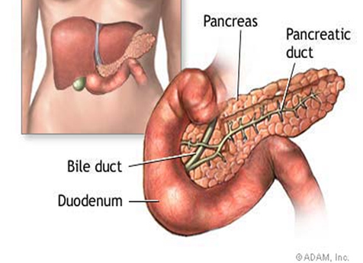
What is Diabetes?
Diabetes is a disease in which the body does not produce or properly use insulin. Insulin is a hormone that is needed to convert sugar, starches and other food into energy needed for daily life.

Slide 22
What is a symptom?
A symptom is any sensation or change in bodily function that is experienced by a patient and is associated with a particular disease. It is observed by the patient himself and is often the reason why he sees the doctor.
Diabetes often goes undiagnosed because many of its symptoms seem so harmless and the patient fails to recognize the early Diabetes and does not see a doctor in time.

Slide 23
What are symptoms of diabetes?
Some diabetes symptoms which a patient mat experience include:
Frequent urination
Excessive thirst
Extreme hunger
Unusual weight loss
Increased fatigue
Irritability
Blurry vision
Bad healing skin sores

Slide 24
What is a sign of a disease?
A sign is an evidence of any particular disease. It is evident to a doctor or a nurse and helps them to diagnose a disease like diabetes.
polyuria, polydipsia and polyphagia are signs of diabetes.

Slide 25

Polyuria: is the excessive passage of urine
(at least 2.5 liters per day for an adult) resulting
in profuse urination and urinary frequency
(the need to urinate frequently).
Polydipsia: Excessive thirst all the time.
Polyphagia: A person with polyphagia eats excessive amounts of food. In uncontrolled diabetes, some of the excess sugar that builds up in the blood passes out of the body in the urine. The calories (energy) that the sugar contains are also lost from the body when this happens. This causes the person to get very hungry and eat large amounts of food to make up for the lost calories.

Slide 26
Types of Diabetes
?

Slide 27
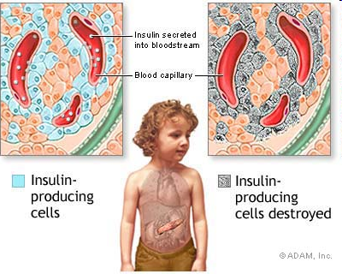
Type 1 diabetes
Type 1 diabetes most often occurs in people younger than 30 years and must be controlled by injecting insulin or by using an insulin pump. In type diabetes, the body does not produce insulin. Insulin is needed for the body to use sugar (glucose). Sugar is the basic fuel for the cells in the body, and insulin takes the sugar from the blood into the cells.

Slide 28
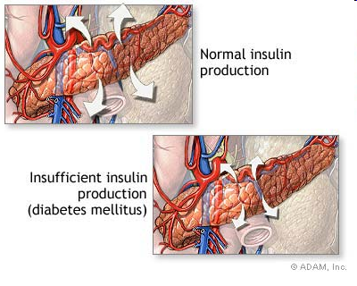
Type 2 diabetes
In type 2 diabetes, either the body does not produce enough insulin or the cells do not use the insulin properly (they are “insulin resistant”).

Slide 29

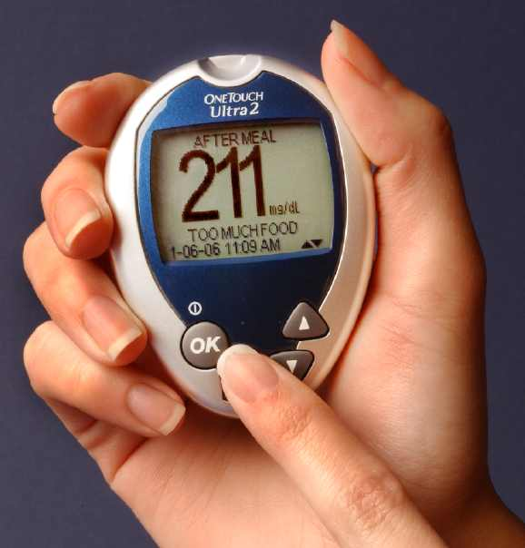
Type 2 Diabetes
Type 2 diabetes is the most common form of diabetes (90–95 percent of people with diabetes in the United States have type 2).
It most often occurs in people older
than 40 years but can occur in younger
people, including children.

Slide 30
Type 2 diabetes occurs most often in people
who are inactive and carry excess weight.
In fact, 9 out of 10 people who are newly diagnosed with type 2 diabetes are overweight. Type 2 diabetes can often be controlled through meal plans and physical activity plans. Some people with type 2 diabetes take diabetes pills or insulin.
The DREAM Project is here to help people with type 2 diabetes manage their diabetes and lead a healthy life.

Slide 31
Gestational diabetes
Gestational diabetes is a type of diabetes that can occur during pregnancy in women who have not been known to have had diabetes before pregnancy.
Women who have had gestational diabetes are at a much higher risk than those without gestational diabetes for developing type 2 diabetes later in life.
The child born to a woman who had gestational diabetes during that pregnancy is also at increased risk for developing type 2 diabetes.
Both can reduce this risk by performing physical activity and by eating healthily to lose weight or to avoid becoming overweight.

Slide 32

Pre-diabetes
Pre-diabetes is a condition in which blood sugar levels are higher than normal but not high enough for the person to be diagnosed with diabetes.
Pre-diabetes is a precursor to diabetes; that is, most people with pre-diabetes will eventually develop diabetes unless they make changes in their eating habits and their physical activity levels.

Slide 33
What is Risk Factor
A risk factor is something or some factor that increases a person's chances of getting a disease. For example, being overweight is a risk factor for developing diabetes in the future.

Slide 34



Who is at Risk?
  Obesity- Number 1 risk for diabetes.
  Sedentary lifestyle (No physical activity)
  Unhealthy eating habits- Which further increases obesity.
  Family history of Diabetes
  Increased Age
  History of Diabetes during Pregnancy ( Gestational Diabetes)
  High Blood Pressure and High Cholesterol
  Being a member of a certain ethnic group- African American, Hispanic, American Indian. Alaska Native, Asian American and Pacific Islander.
  BUT, THE GOOD NEWS IS, MOST OF THEM CAN BE TURNED
  AROUND TO HELP REVERSE OR PREVENT TYPE 2 DIABETES!

Slide 35
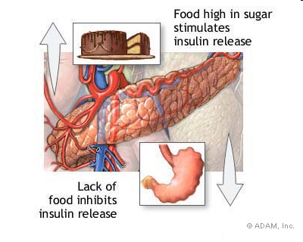
HIGH BLOOD SUGAR
High Blood Sugar or Hyperglycemia can cause:
Feeling Tired
Weight Loss
Feeling Thirsty
Blurry Vision
Need to Urinate Often

Slide 36

LOW BLOOD SUGAR
Insulin and pills help control diabetes but can
sometimes cause low Blood sugar (Hypoglycemia.)
This can happen if you:
Are too active
Skip a meal
Don’t eat enough
Take too much Medicine

Slide 37
What can you do when you have low Blood Sugar?

Slide 38

1. Drink ½ can of Regular soda
2. Eat 3 hard candies (lozenges), quickly- show examples
3. 1 Tablespoon of real sugar or 2 packets of sugar.

Slide 39


DIABETES MANAGEMENT STRATEGIES

Slide 40
Managing your Diabetes using a Health Care Provider

Slide 41
ABC’s of Diabetes ?
A for A1C
B for Blood Pressure
C for Cholesterol

Slide 42

A for the A1C test (A-one-C).

Slide 43

What is HbA1c?
HbA1c stands for "hemoglobin A1c".
This test is a simple lab test that shows the average amount of sugar in your blood over the last two to three months. High blood glucose levels can harm your heart and blood vessels,
kidneys, feet, and eyes.
It’s the best way to find out if your blood sugar is under control. All people with type 2 diabetes should have a hemoglobin A1c test at least twice a year.

Slide 44
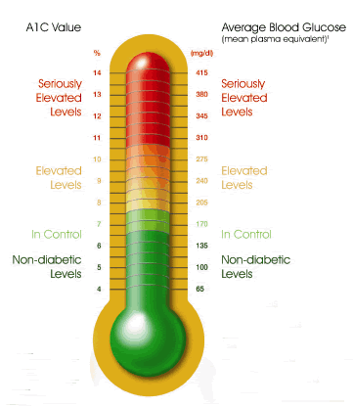
Regular testing will help you and your doctor to track your blood sugar levels over time and plan long-term treatment options to reach your target level of control.
If your treatment changes or if your blood sugar level stays too high, you should get a hemoglobin A1c test at least every three months until your blood sugar level improves.

Slide 45

  Ask your health care team what your A1C number is, what it should be, and what you need to do to reach your A1C goal.
  Ask for an A1c test at least twice a year.

Slide 46
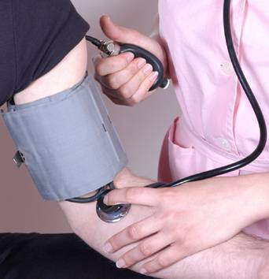
B for Blood pressure.
The goal for most people with diabetes is below 130/80.
High blood pressure makes your heart work too hard. It can cause heart attack, stroke, and kidney disease

Slide 47

C for Cholesterol (ko-LES-ter-ol)
The LDL goal for most people is below 100.
The HDL goal for most people is above 40 Slides for this section

Slide 48

ABC’s of Diabetes
Talk to you health care team about how to manage your A1C, Blood pressure, and Cholesterol.
This can help lower your chances of having a heart attack, stroke, or other diabetes problems.

Slide 49

Ask your health care team:
what your A1C, blood pressure, and cholesterol numbers are
what your ABC numbers should be
what you can do to reach your targets

Slide 50
GET ROUTINE CARE

Slide 51
Tips for Your Doctors Visit
See your health care team at least twice a year to find and treat any problems early. Ask what steps you can take to reach your goals.
  At each visit be sure you have a:
  blood pressure check
  foot check
  weight check. Try to attain a body mass index of 25 (but the average diabetic is 40 pounds overweight!) Your Body Mass Index or BMI is calculated based on your height and weight and measures your body fat.

Slide 52
Yearly check-ups
Once each year be sure you have a:
cholesterol test
triglyceride (try-GLISS-er-ide) test — a type of blood fat
complete foot exam
dental exam to check teeth and gums — tell your dentist you have diabetes

Slide 53
Yearly check-ups
dilated eye exam to check for eye problems
flu shot
urine and a blood test to check for kidney problems
Talk to your doctor about ACE inhibitors (lisinopril, ramipril, etc) to keep the kidneys from failing
pneumonia (nu-mo-nya) shot

Slide 54
Ways of Managing your Diabetes at Home

Slide 55
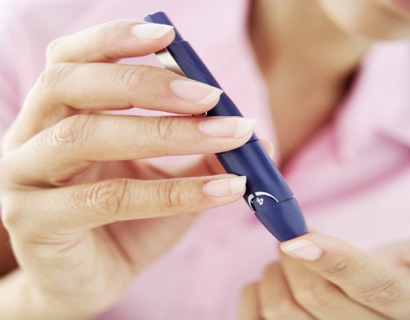
Self-monitoring of blood glucose (SMBG)
Self monitoring of blood glucose or SMBG, with a meter helps you see how food, physical activity, and medicine affect your blood glucose levels. The reading you can get help you manage your diabetes day by day or even hour by hour. Keep a record of your test results and review it at each visit with your health care team.

Slide 56
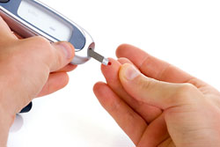
  Check your own blood glucose as often as needed and go over the results at each visit with your doctor and health care team.
  Please note that not everyone needs to monitor their sugar levels at home on a regular basis. You should speak to your doctor to see if he/she recommends it for you.
  Talk to your health care team about your A1c goals and your SMBG goals.

Slide 57
Finger stick Targets
Finger stick Targets:
  90-130: before meals
  Less than 180: 1-2 hours after meals
  Glucose levels over 250 cause frequent urination

Slide 58
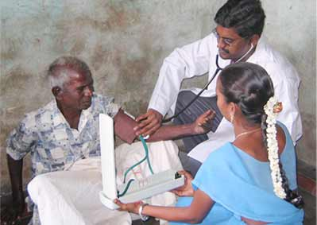
  When your blood glucose is close to normal you are likely to:
    have more energy
    be less tired and thirsty and urinate less often
    heal better and have fewer skin or bladder infections
    have fewer problems with your eyesight, feet, and gums

Slide 59
TAKE YOUR MEDICATIONS REGULARLY
Take medicines even when you feel good.
Ask your doctor if you need aspirin to prevent a heart attack or stroke.
Tell your doctor if you cannot afford your medicines or if you have any side effects.

Slide 60

EATING HEALTHY

Slide 61
Diabetes meal plan
It is a guide that tells you how much and what kinds of food you can choose to eat at meals and snack times.
A good meal plan should fit in with your schedule and eating habits.
The right meal plan will help you improve your blood glucose, blood pressure, and cholesterol numbers and also help keep your weight on track.
a meal plan helps ensure you eat a balanced diet high in fiber and low in fats. It can also "help you lose weight, by controlling portion sizes and calories
With that in mind -- and understanding you should talk with your doctor before making big changes in your diabetes diet

Slide 62
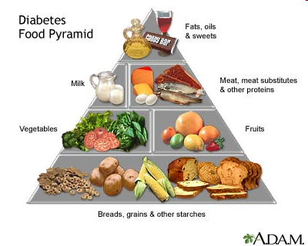
The diabetes food pyramid's general recommendations are:
Grains, beans, and starchy vegetables: 6 or more servings/day. One serving: 1 slice bread; 1/2 small bagel; 1/2 cup cooked cereal, pasta, rice; 3/4 cup ready-to-eat cereal; 1/2 cup cooked beans, corn, peas.
Fruits: 2-4 servings daily. One serving: 1 medium-size fresh fruit; 1/2 cup canned fruit; 1/2 cup fruit juice.
Vegetables: 3-5 servings a day. One serving: 1 cup raw vegetable; 1/2 cup vegetable juice.
Meat, Fish, Cheese: 2-3 servings/day. One serving: 2-3 ounces cooked lean meat, skinless poultry, or fish; I egg; 2 tablespoons peanut butter; 2-3 ounces cheese.
Milk and Yogurt: 2-3 servings daily. One serving: 1 cup (8 ounces) milk or yogurt.
Fats, Sweets, and Alcohol: eat these in small amounts. One serving: 1 teaspoon butter, margarine, or mayonnaise; 1 tablespoon cream cheese or salad dressing; 1/2 cup ice cream.
Notes:
http://diabetes.webmd.com/features/4-systems-for-diabetes-meal-planning

Slide 63

Stress Management

Slide 64
Stress & Diabetes
Stress can be physical or mental.
It can complicate diabetes by distracting you from proper care or affecting blood glucose levels directly.
Learning to relax and making lifestyle changes can help reduce mental stress.
Smoking is not a good way of stress management, and can cause further complications to your diabetes. So if you are a smoker, think of quitting! We will discuss how in another session! ☺

Slide 65
A diary works best if you can write each thing
down as you do it. That way you won’t forget.
Write down any special things you did that may affect your blood sugar numbers. For example, some foods can cause numbers to be higher, and exercise may cause numbers to be lower.

Slide 66

Maintain “My Personal Health Diary”
Keep daily records in a diary or on a record sheet of:
Your blood sugar levels
The food you eat
The exercise you get
The medication you take
Ketones (if any)

Slide 67
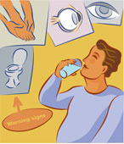

Complications of diabetes

Slide 68
  Heart Attacks- the most common cause of death in diabetics is strokes.
  Kidney disease- diabetes is the most common cause of end-stage kidney disease in the U.S.
  Amputations- the most common cause of lower extremity amputations
  Blindness- the most common cause of blindness in adults

Slide 69


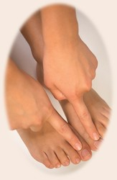
Take medicines even when you feel good
Check your feet every day
Brush your teeth and floss every day
Check your blood glucose
Check your blood pressure
Report any changes in your eyesight

Slide 70

When you are sick

Slide 71

What to do when you are sick
When you are sick…
You will need a special plan for days you are sick. On sick days:
Always take your medicine
Test your blood sugar and ketones at least every 4 hours
Drink beverages with sugar if you can’t eat (it’s important to drink a lot of fluids when you are sick)

Slide 72


Contact your doctor when…
Call your doctor if you:
Can’t eat
Are vomiting
Have severe diarrhea
Have blood sugar numbers outside of your goal range
Have ketones

Slide 73




Physical Activity

Slide 74
Physical Activity
Try to get at least 30 minutes of moderate-intensity physical activity five days a week.
If you have not been active, start off slowly, building up to your goal.
Try brisk walking, dancing, swimming, biking, jogging, or any physical activity that helps get your heart rate up.
You don’t have to get all your physical activity at one time. Try getting some physical activity throughout the day in 10 minute sessions

Slide 75

DREAM CALENDAR

Slide 76
Feedback

